Slide 1


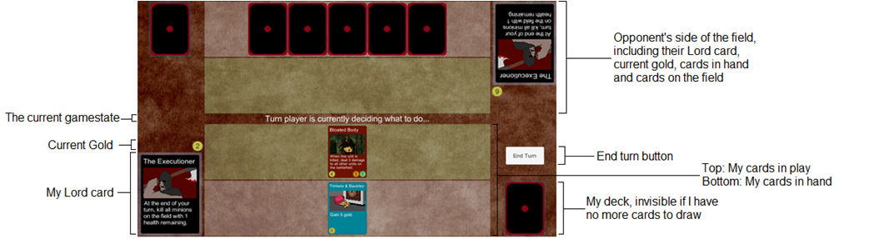
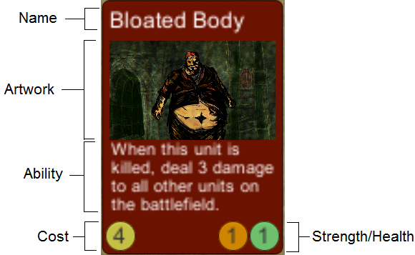
Lords: An Online Deck-Building Game
Developer: Tyler Thorn
Supervisor: Joseph Walton-Rivers
Project Features
How To Play
(Summarized)
A custom C# server running a 1-on-1 online multiplayer card game
Dark fantasy theme
Designed with resource management in mind
A wide variety of cards with different effects
Lord cards with powerful abilities that can turn the tide of battle
Employ a variety of strategies – overwhelm your opponent with swarms of units, or manage your gold carefully and win the long game
Each player starts with 25 gold
Players take it in turns to play as many cards from their hand as they like.
Each card played has a cost in gold that must be paid.
Players can attack their opponent’s cards with their own. Each card loses health equal to the other’s strength. Cards that reach 0 health are killed.
Players can attack their opponent’s gold reserves if their opponent has no cards in play.
The first player to reach 0 gold loses.
Game layout
Card Layout

Slide 2
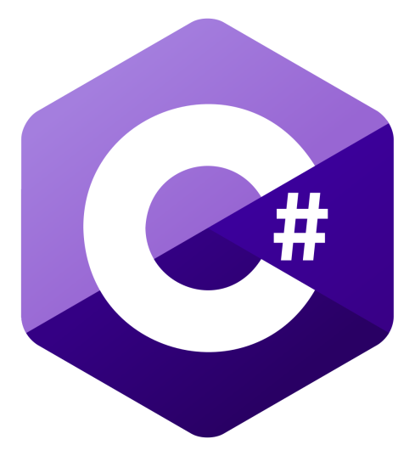
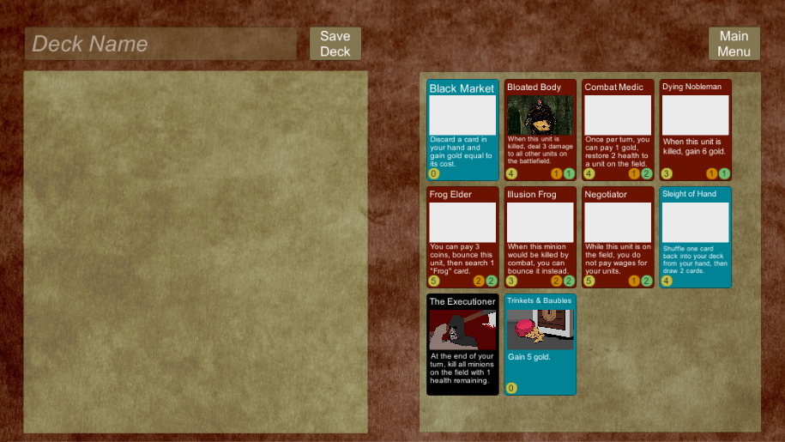
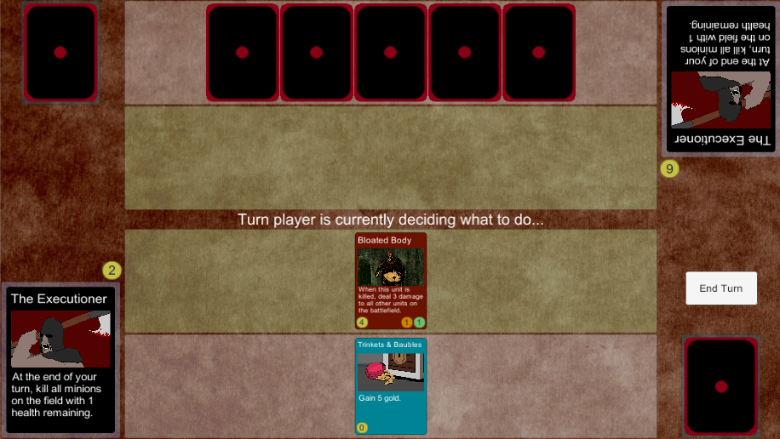

Lords: An Online Deck-Building Game
Developer: Tyler Thorn
Supervisor: Joseph Walton-Rivers
Project Features
Card Layout
A custom C# server running a 1-on-1 online multiplayer card game
Dark fantasy theme
Designed with resource management in mind
A wide variety of cards with different effects
Lord cards with powerful abilities that can turn the tide of battle
Employ a variety of strategies – overwhelm your opponent with swarms of units, or manage your gold carefully and win the long game
Screenshots

Slide 3
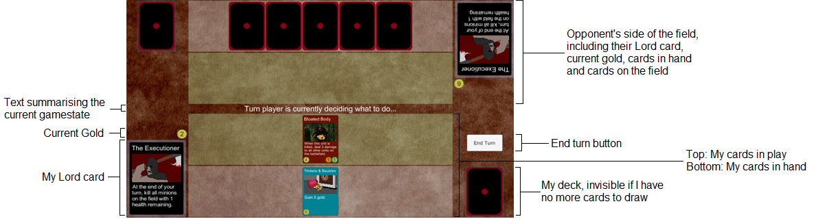
Lords: An Online Deck-Building Game
Developer: Tyler Thorn
Supervisor: Joseph Walton-Rivers
Project Features
Card Layout
A custom C# server running a 1-on-1 online multiplayer card game
Dark fantasy theme
Designed with resource management in mind
A wide variety of cards with different effects
Lord cards with powerful abilities that can turn the tide of battle
Employ a variety of strategies – overwhelm your opponent with swarms of units, or manage your gold carefully and win the long game
Game layout

